Slide 1
σ-map without saliency map
traverse through a predefined sequence of σ values
[1,1.5,2,4,7,10,15,20,25,30,35,45,55,65,75,85,105,125,145,165,185,225]
for each pixel location, find the Wasserstein distortion on pixel values between two consecutive σ values
a rule to determine the σ value at the location

Slide 2
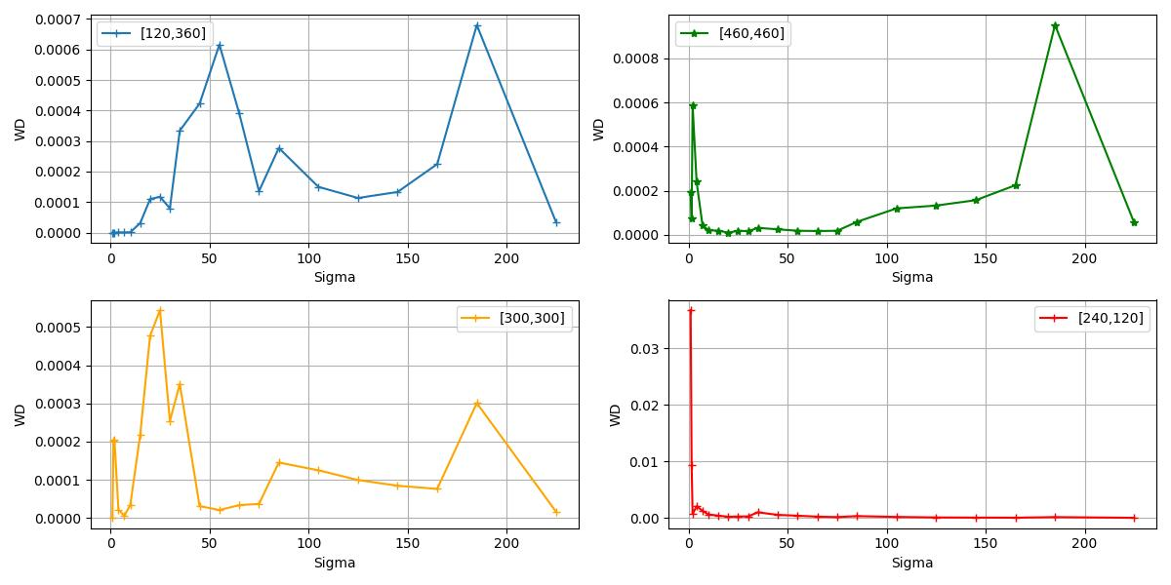
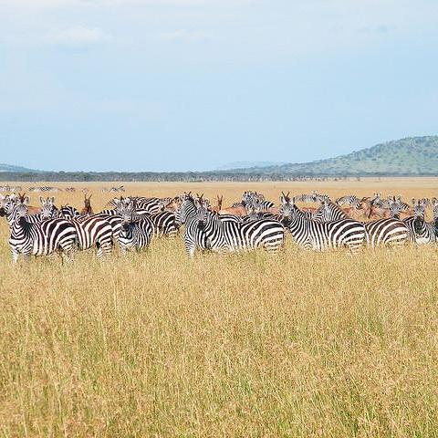
σ-map rule

Slide 3
σ-map rule
ref
ref=0
ref
ref
rule for optimal σ :
highest peak within first five distortions is set as ref

Slide 4
σ-map rule
ref
ref=0
ref
ratio too small, σ = 0
ref
rule for optimal σ :
highest peak within first five distortions is set as ref
find the first peak after ref such that the ratio of ref to peak is larger than some threshold, and set σ = first σ for that distortion; otherwise σ = 0

Slide 5
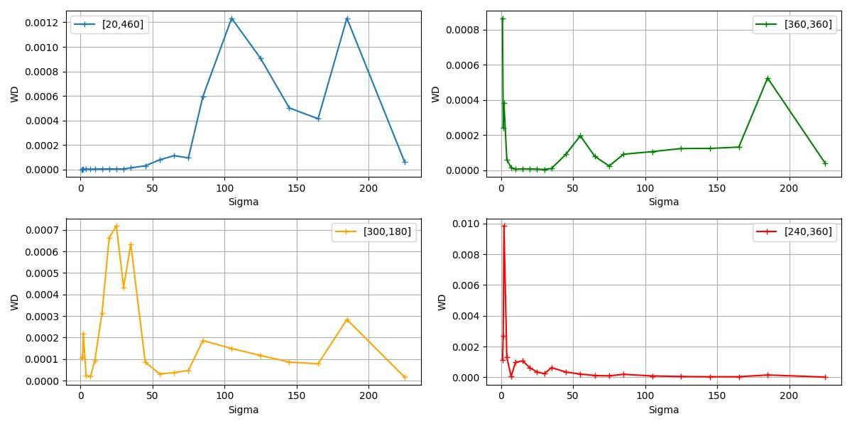
σ-map rule
ref
ref=0
ref
ref
rule for optimal σ :
highest peak within first five distortions is set as ref
find the first peak after ref such that the ratio of ref to peak is larger than some threshold, and set σ = first σ for that distortion; otherwise σ = 0

Slide 6
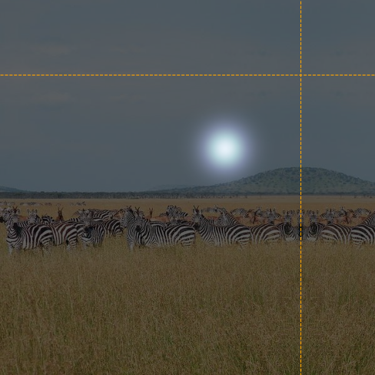
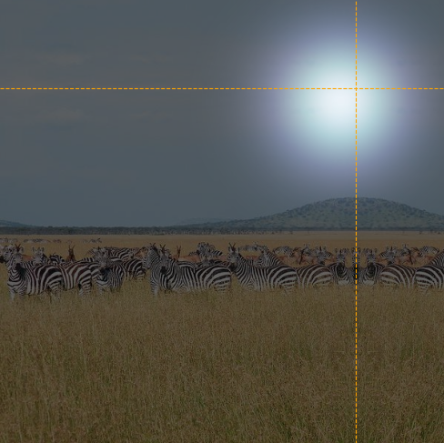
σ values

Slide 7
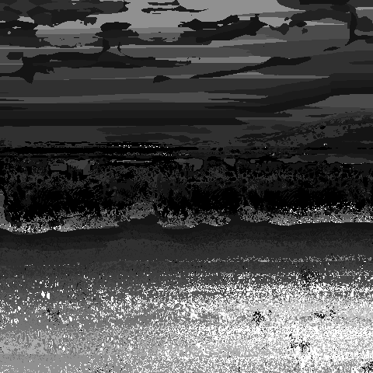
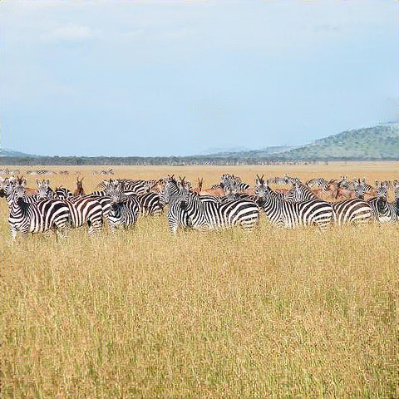
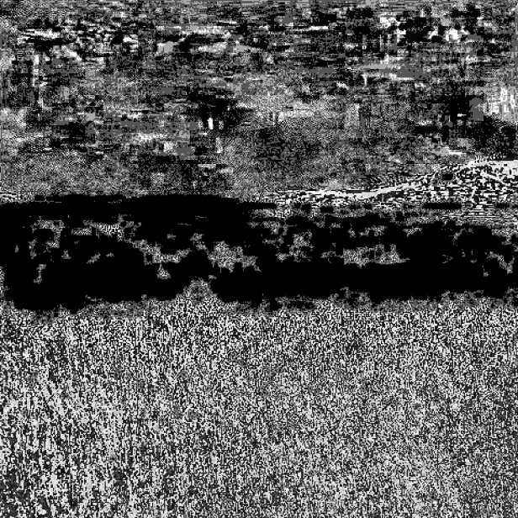
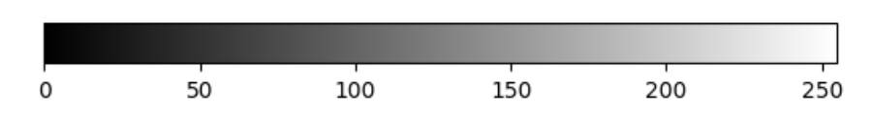
results
σ map
source
reconstruction
difference

Slide 8
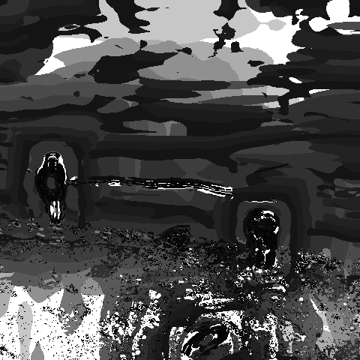
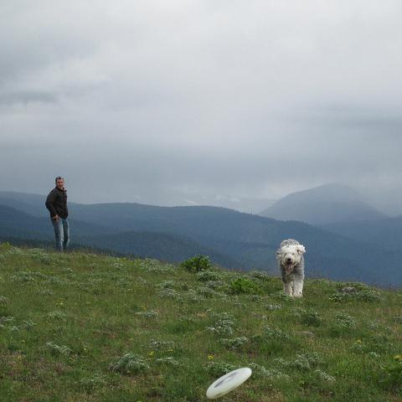
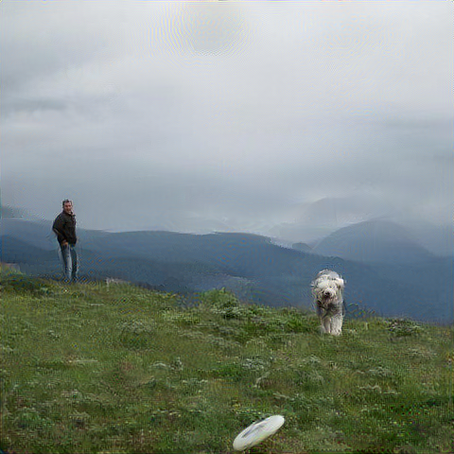
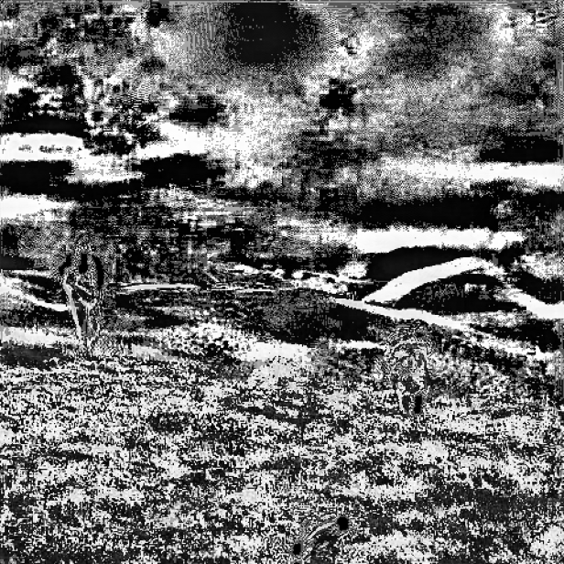
results
σ map
source
reconstruction
difference

Slide 9
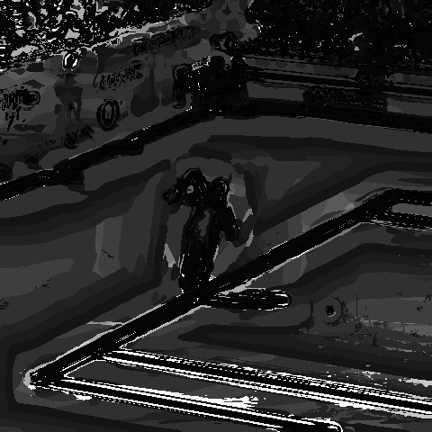
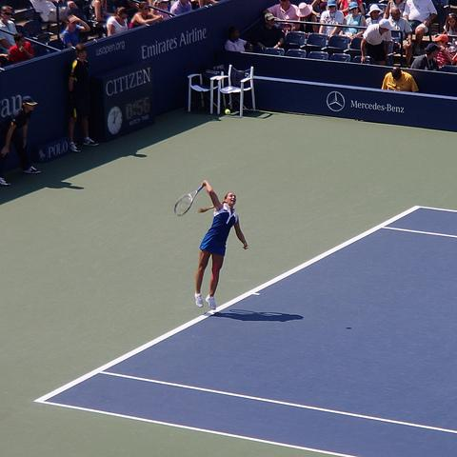
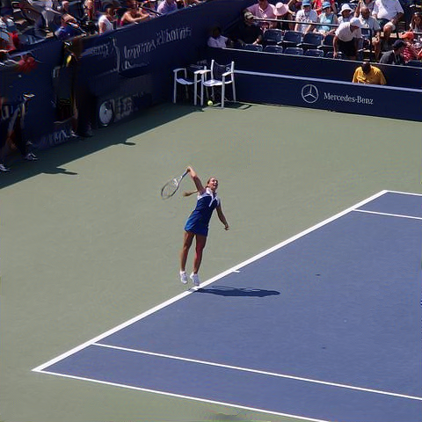
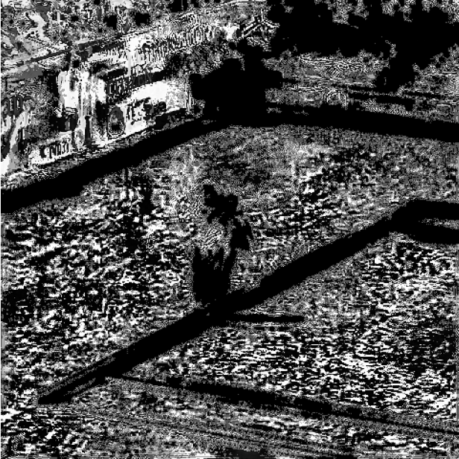
results
σ map
source
reconstruction
difference

Slide 10
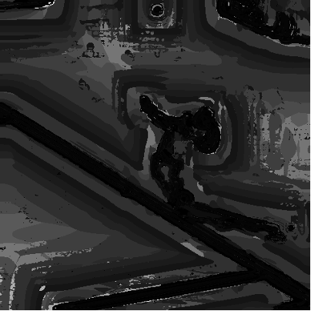
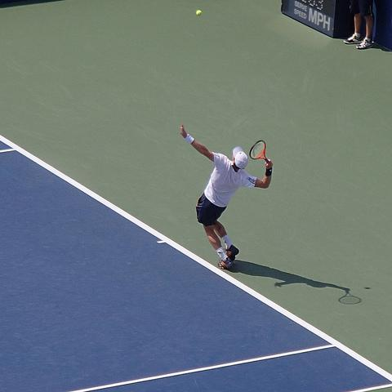

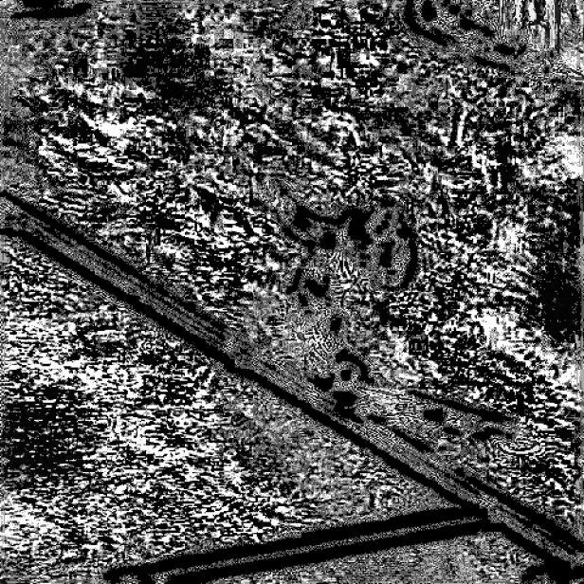
results
σ map
source
reconstruction
difference

Slide 11
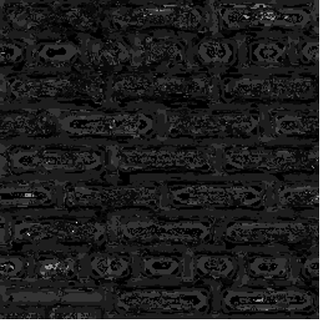
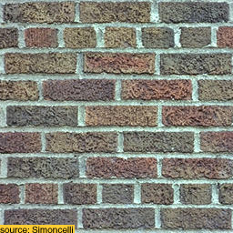
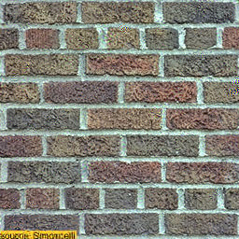
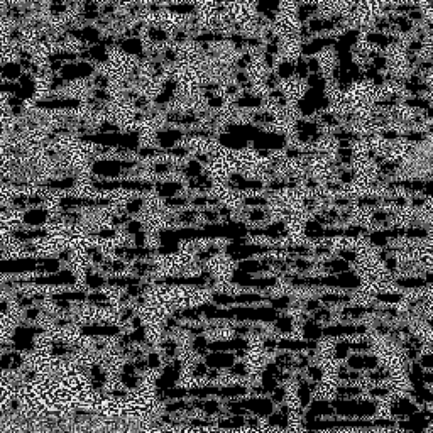
results
σ map
source
reconstruction
difference

Slide 12
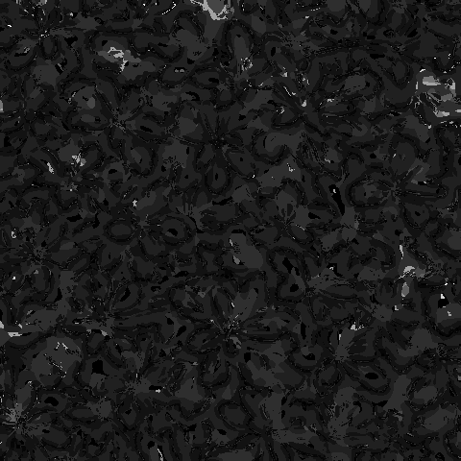


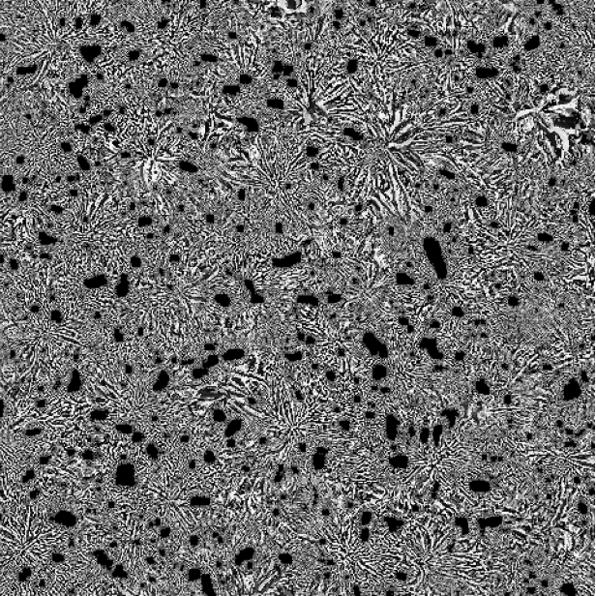
results – failure mode?
σ map
source
reconstruction
difference
textures when each ‘unit’ has a nontrivial area
desired behaviour for bricks/tiles, but not for leaves?

Slide 13
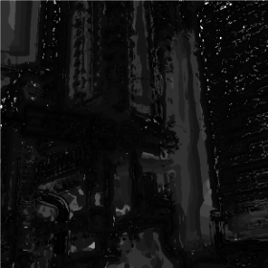
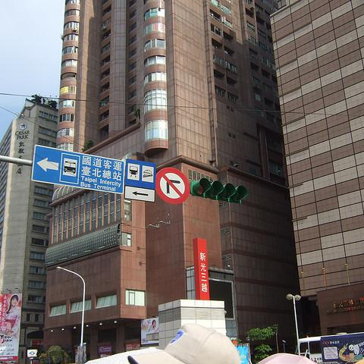
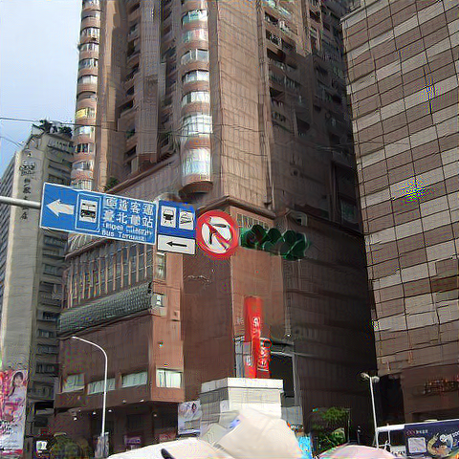
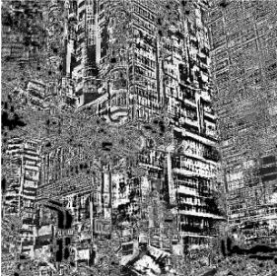
results – failure mode
σ map
source
reconstruction
difference

Slide 14
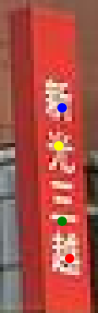

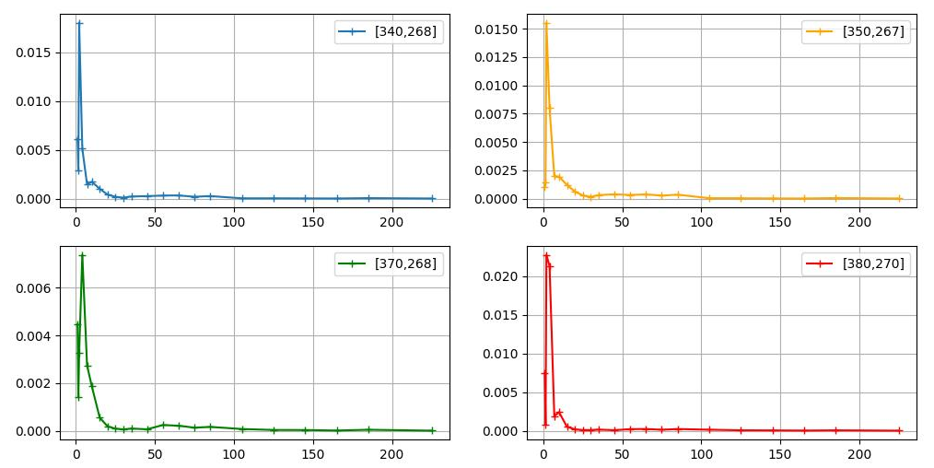

results – failure mode
source
σ map
σ = 7
σ = 7
σ = 4
σ = 7

Slide 15
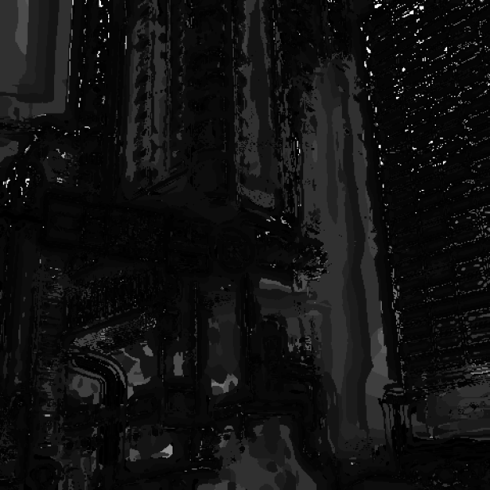

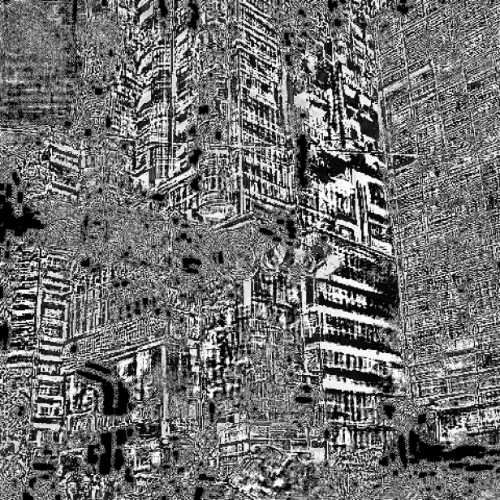
results
σ map
source
reconstruction
difference
a more stringent threshold helps

Slide 16
results
a more stringent threshold helps

Slide 17
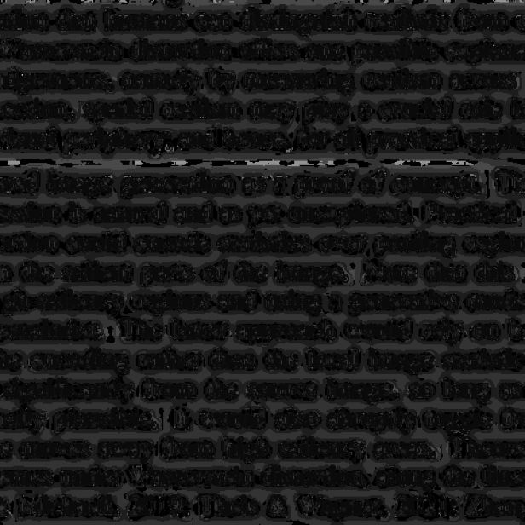
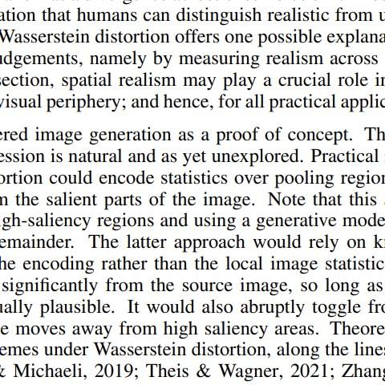
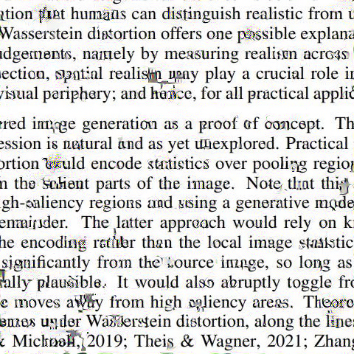
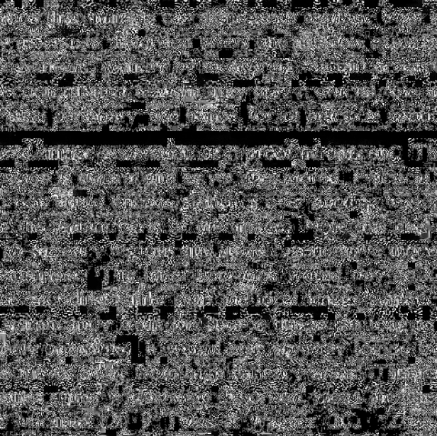
results – failure mode?
σ map
source
reconstruction
difference
too much artifacts

Slide 18
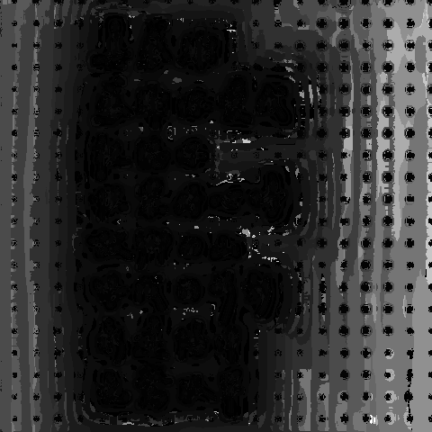
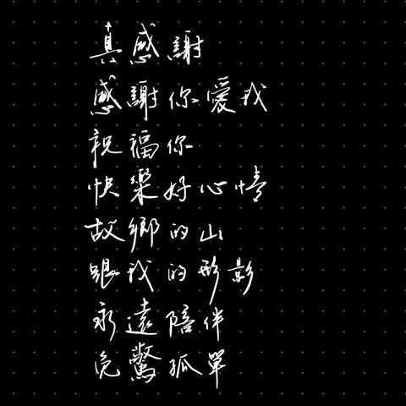
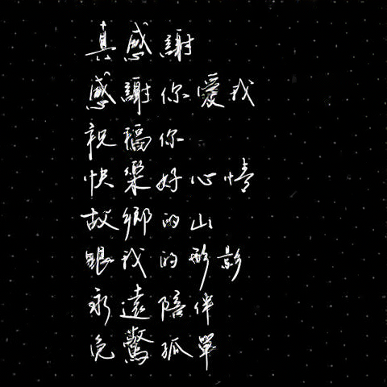
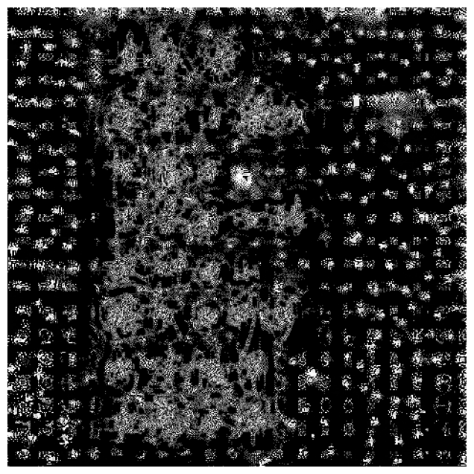
results – failure mode?
σ map
source
reconstruction
difference
subtle non-texture recognized as texture

